Slide 1
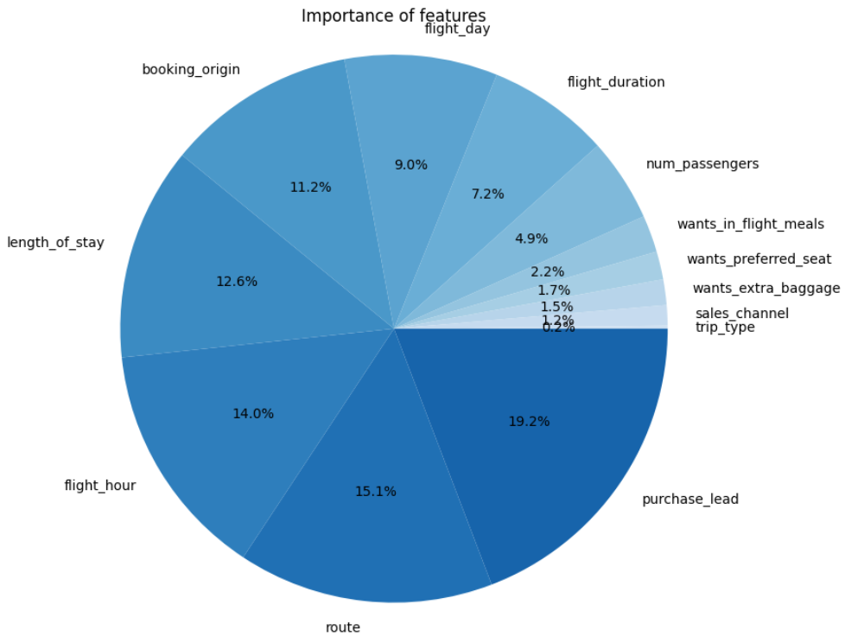
Relative importance of features
When predicting booking complete
More Data is required
Approximately 85% score with the current set of data. To test the model in production, we need larger samples of data.
Purchase lead, Tour and Flight hour are important
The purchase lead, tour and flight hour are important features in the model but trip type and sales channel are not.
More Data
The purchase lead was significant feature for the model. With more data, certainly the accuracy of the model will be increase to have best results

